Slide 1
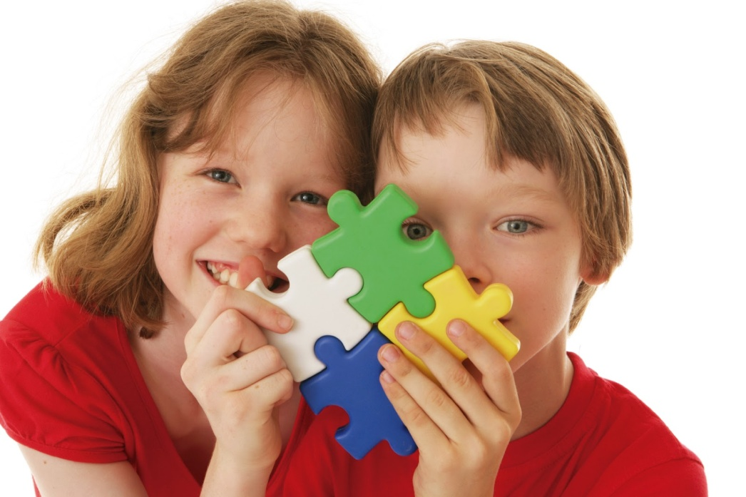
Guess the animal!

Slide 6
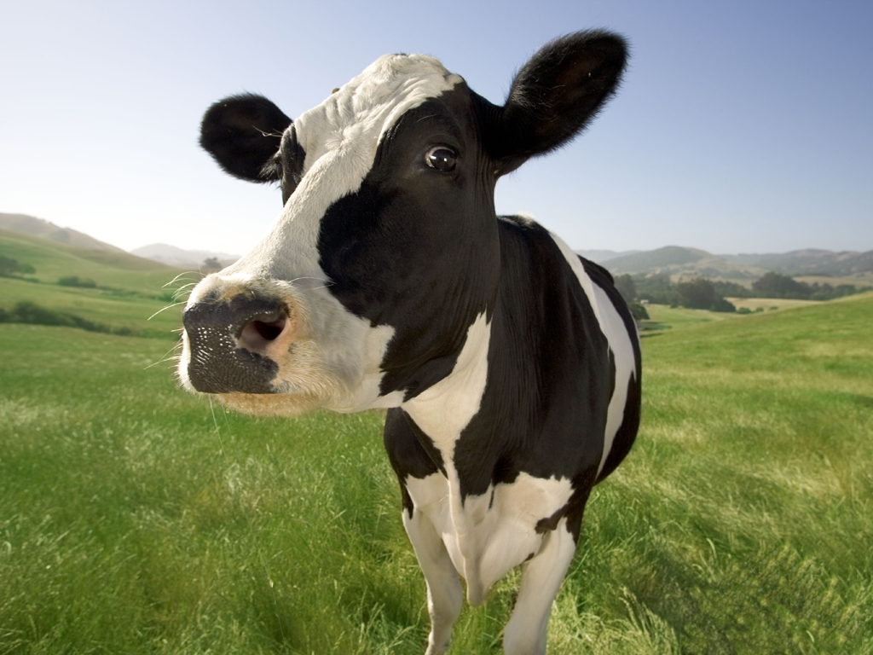
My favorite animal is herbivore.
It lives on land. This animal can walk on its four legs.
It is a viviparous animal. Because, this animal is born from its mother´s womb.
It is a vertebrate animal.
My favorite animal is a mammal.
This animal produces the milk that you drink every morning!
The sound of this animal is : MOO, MOO!

Slide 7
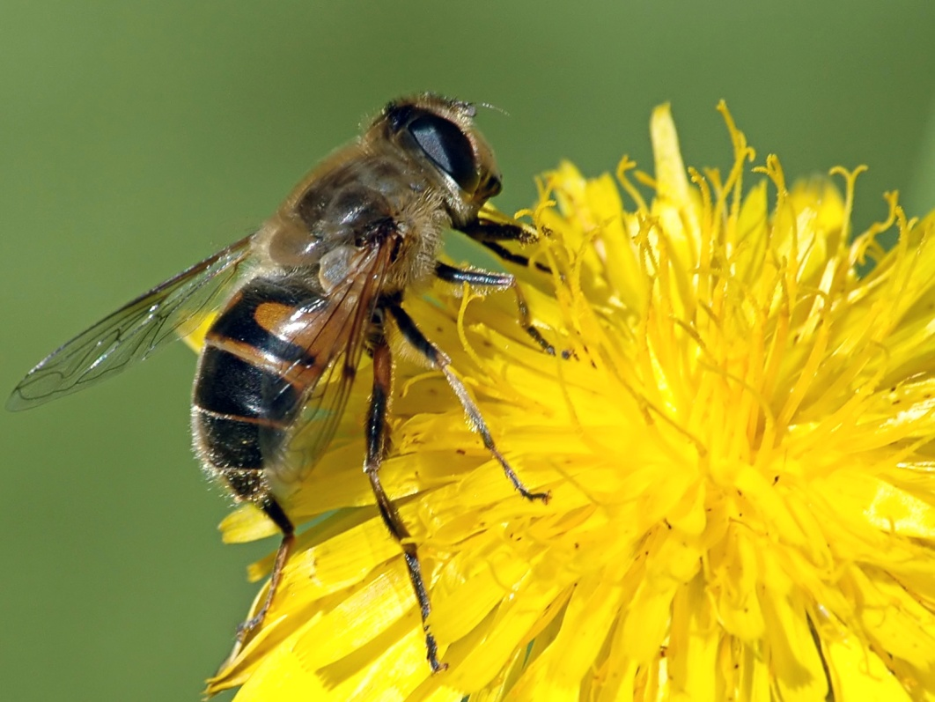
My favorite animal is an invertebrate animal.
It is oviparous. It comes from eggs.
It has wings, and it can fly.
Also It can walk with its six feet.
It has antennaes.
It is an insect
It loves pollen. With it, it makes honey.

Slide 8
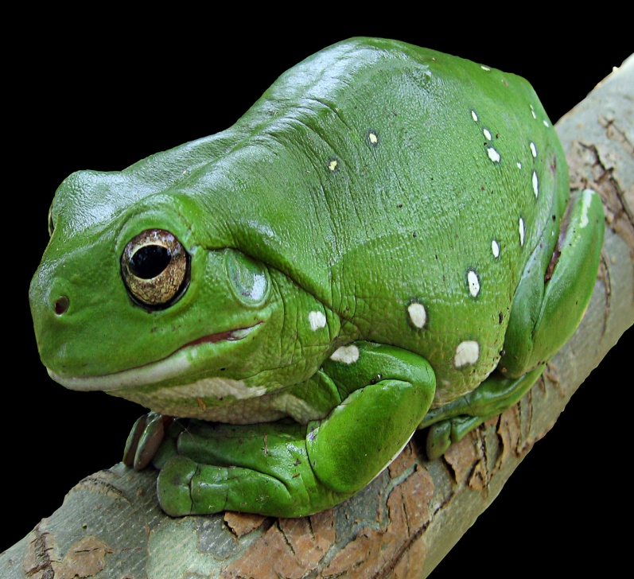
My favorite animal is a vertebrate animal.
It comes from eggs. It´s an oviparous animal!
It loves insects. So it´s a herbivore animal.
It´s a cold-blooded animal.
It has a moist skin, because it´s amphibian.
It has four legs to walk and jump on the land. But it usually lives in water.
It says: CROAK, CROAK!

