Slide 1
True or False?
Let´s make a review!

Slide 2
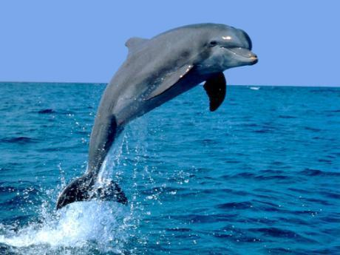
TRUE OR FALSE?
Only fish can have fins.
FALSE!
Also, there are mammals that have got fins!

Slide 3
True or False!
Birds and mammals are warm- blooded
TRUE
The body temperature of mammals is constant. They don´t depend on the temperature of their surroundings. For this reason, they are warm-blooded

Slide 4
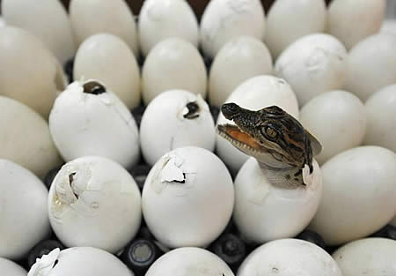
True or false
Reptiles come from eggs, they are oviparous
TRUE

Slide 5
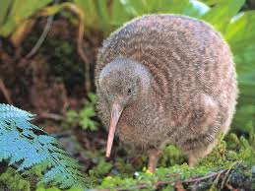
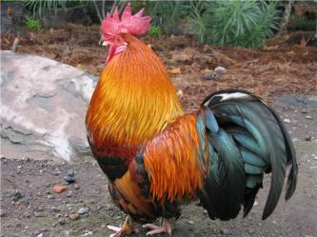
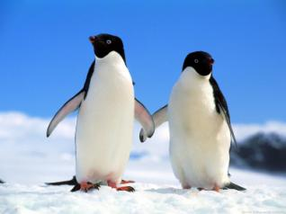
True or false!
False!
All birds can fly
All birds have wings, but some birds can´t fly, as:
Hens
- Penguins
Cocks

Slide 6
TRUE OR FALSE
Mammals have got feathers
FALSE!
Mammals have got fur or hair on their skin

Slide 7
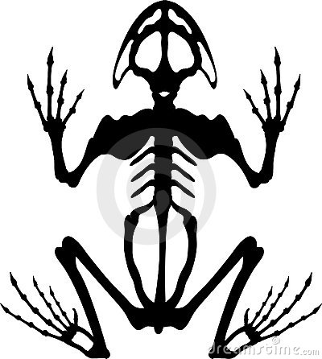
TRUE OR FALSE
Toads, salamanders and frogs are invertebrate amphibians.
False
All amphibians are vertebrate animals

Slide 8
TRUE OR FALSE
Invertebrates have a spine
False
Invertebrates don´t have a spine.

Slide 9
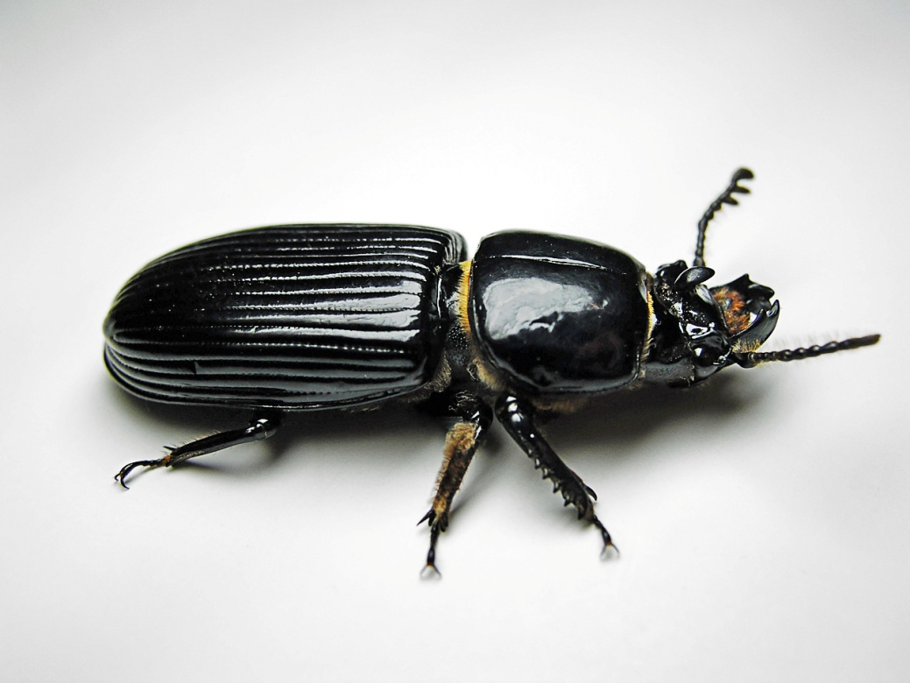
TRUE OR FALSE
TRUE
This beetle´s got a shell to protect its body.
Some invertebrates have shells to protect their bodies

Slide 10
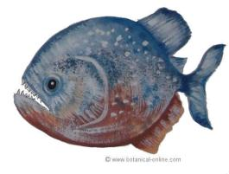
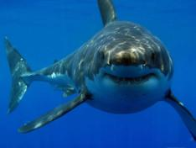
TRUE OR FALSE
There are some carnivore fish
TRUE
Piranhas and sharks are examples of carnivore fish

Slide 11
True or false
Ants, birds, butterflies and beetles are insects.
false
Birds are not insects. Birds are vertebrate animals

Slide 12
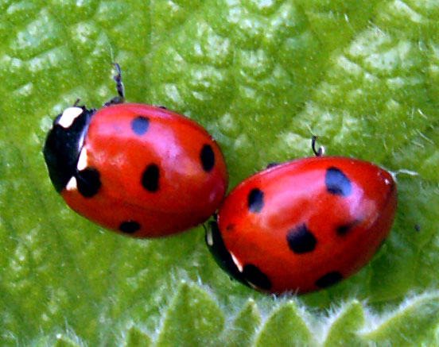
Ladybirds are vertebrate animals
False
They are insects, so they are invertebrates

